Slide 1

Standards for Diamond OA
3rd Global Summit on Diamond Open Access

Slide 2





91
140
14,802
languages
countries
No fee journals

Slide 3
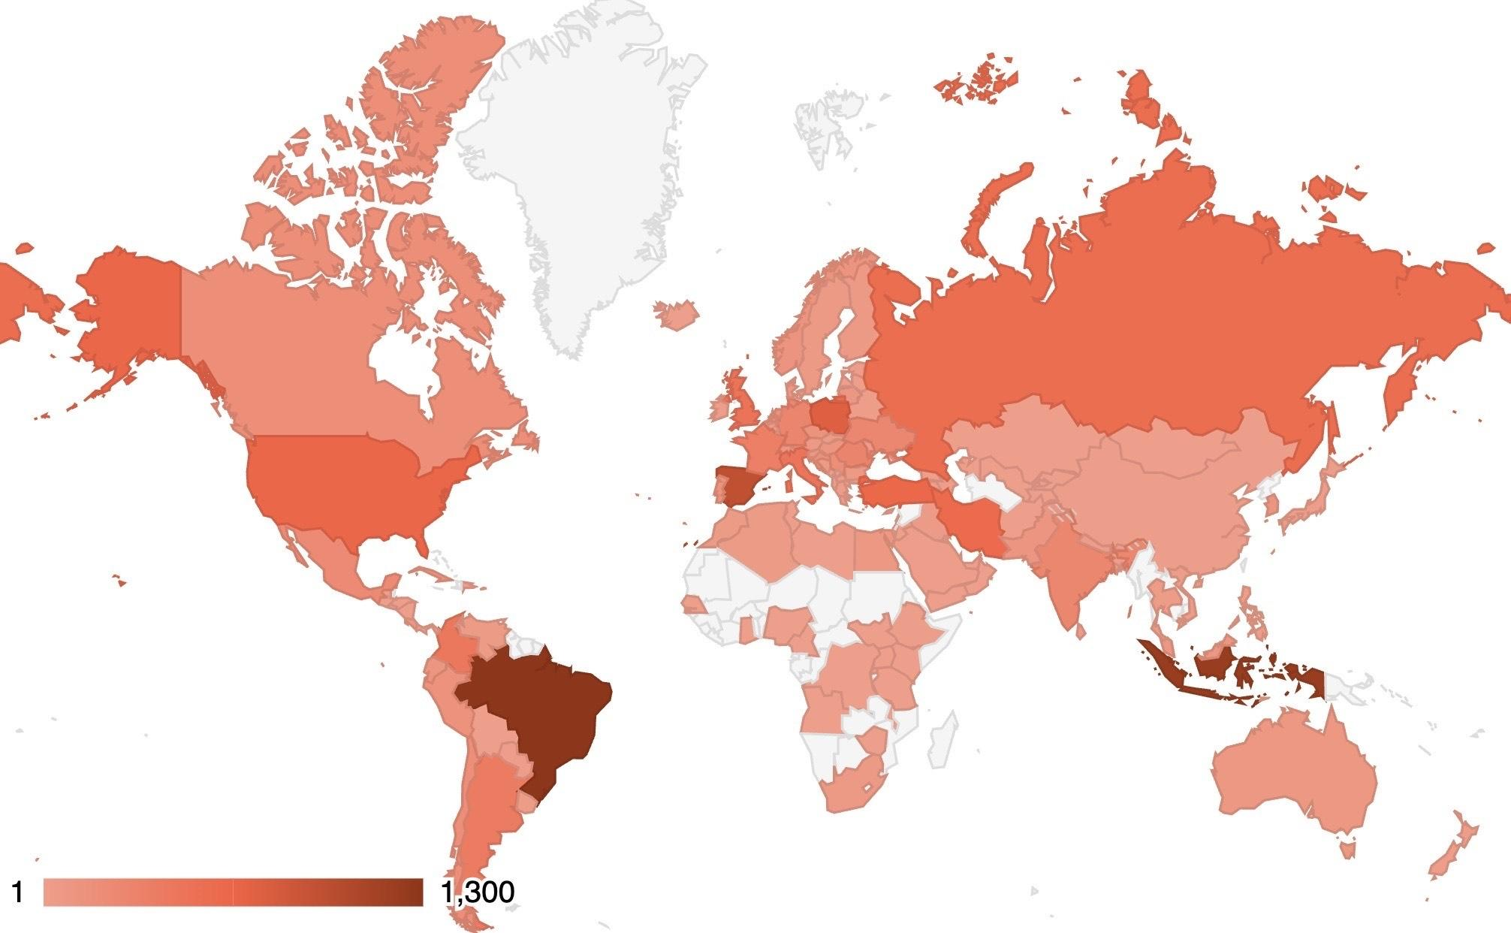

Slide 4

DOAJ’s evaluation criteria are a gold standard for open access publishing
They cover…
Open Access, copyright and licensing
Transparency: editorial board, peer review, and journal ownership
Editorial and publishing standards
Website and functionality
Operations: editorial independence, business model and archiving

Slide 5
Publishing practices vary across regions, disciplines, and types of publisher.
DOAJ’s standards are the same for everyone, but our evaluation service aims to be equitable.

Slide 6




DOAJ Review and decision
Application
Initial checks
Independent review
Final decision
Feedback
Publisher/editor
DOAJ Triage team
DOAJ Editorial team
DOAJ Managing Editor
Publisher/editor

Slide 7
Our standard is developed with input from the community

Slide 8

Our ambassador programme
DOAJ Ambassadors are volunteers from all over the world.
Ambassadors…
promote journal quality and the importance of standards
advocate for open access
Bring local knowledge and expertise
support DOAJ indexing for local journal editors and publishers
Ambassadors Gimena del Rio Riande and Ivonne Lujano

Slide 9


Slide 10
The first set of slides are examples of how to build a good DOAJ presentation

Slide 11
Font and style
You should use the same font throughout your presentation.
The font we use for our slides is called Inter (light)
And Inter (semi bold) for titles
Colour codes and information about accessibility can be found here https://doaj-kit.netlify.app/building-blocks/colours/

Slide 12
Using bullet points
Make sure bullet points aren’t sentences
Bullet points should work as prompts only
In some cases, it may be necessary to add sentences (see examples on the next slides)

Slide 13
Adding sentences as bullet points (example)
1
Larger sentences or topics can be added as bullet points by splitting the points over several slides and using numbers
2
This means you can add several points that require more information, without overwhelming the audience with information

Slide 14
Adding sentences as bullet points (example)
The journal must…
not have had an application rejected within the last 6 months
not have another application in progress
not already be indexed in DOAJ
have a working website dedicated to the journal

Slide 15
Adding sentences as bullet points (example)
Our metadata is integrated with library discovery systems & gives users access to a more diverse range of content
Our metadata is used in other systems used by libraries and enabling a transition to OA, eg. Unsub, Plan S Journal Checker Tool, Sherpa Romeo

Slide 16

Bullet points (example)
To make your slides more visually appealing, you can use some of our shapes on the side (design of this made by Sophy)
Or, you can just use this slide and change the text

Slide 17


Using DOAJ shapes as bullet points (example 1)
Can be a good tool if you want some points to stand out
Shouldn’t be used on every slide you have bullet points
Think about what shapes you put next to the text
Remember to make sure the bullet points align if you download the presentation to PowerPoint (the layout will change slightly)

Slide 18


Using DOAJ shapes as bullet points (example 2)
Can be a good tool if you want some points to stand out
Shouldn’t be used on every slide you have bullet points
Think about what shapes you put next to the text
Remember to make sure the bullet points align if you download the presentation to PowerPoint (the layout will change slightly)

Slide 19

Highlighting data
Important data can be highlighted in bold, see examples here!
7,926 applications & 4,126 update requests from journals
24% of applications accepted for inclusion
Average review time under three months
20 core staff, >100 volunteer associate editors & 21 ambassadors
Notes:
In 2022 over 8,000 journals applied to be indexed in DOAJ, and every one of those applications was handled by a volunteer and/or a Managing Editor.

Slide 20
Making a text slide more interesting
All journal content must be open access
Immediate access - no delay or embargo
No registration requirement
A paid-for print version is allowed
Journals must display an open access statement and adhere to DOAJ’s definition of open access

Slide 21
This slide can be used to introduce a new topic

Slide 22
“
This is a good way of adding a quote that you want to stand out.
”
Remember to also include your source

Slide 23

Cool, and DOAJ is open!
You can play around with images and shapes, but make sure to use the branded colours (like the grey here), and keep the slides clean and tidy.
Always remember to credit the owner of the image, even if it is a CC 0
Image by Alan King (CC 0)
Notes:
Image from Unsplash: https://unsplash.com/photos/KZv7w34tluA
At this point, I know you’re all thinking…

Slide 24
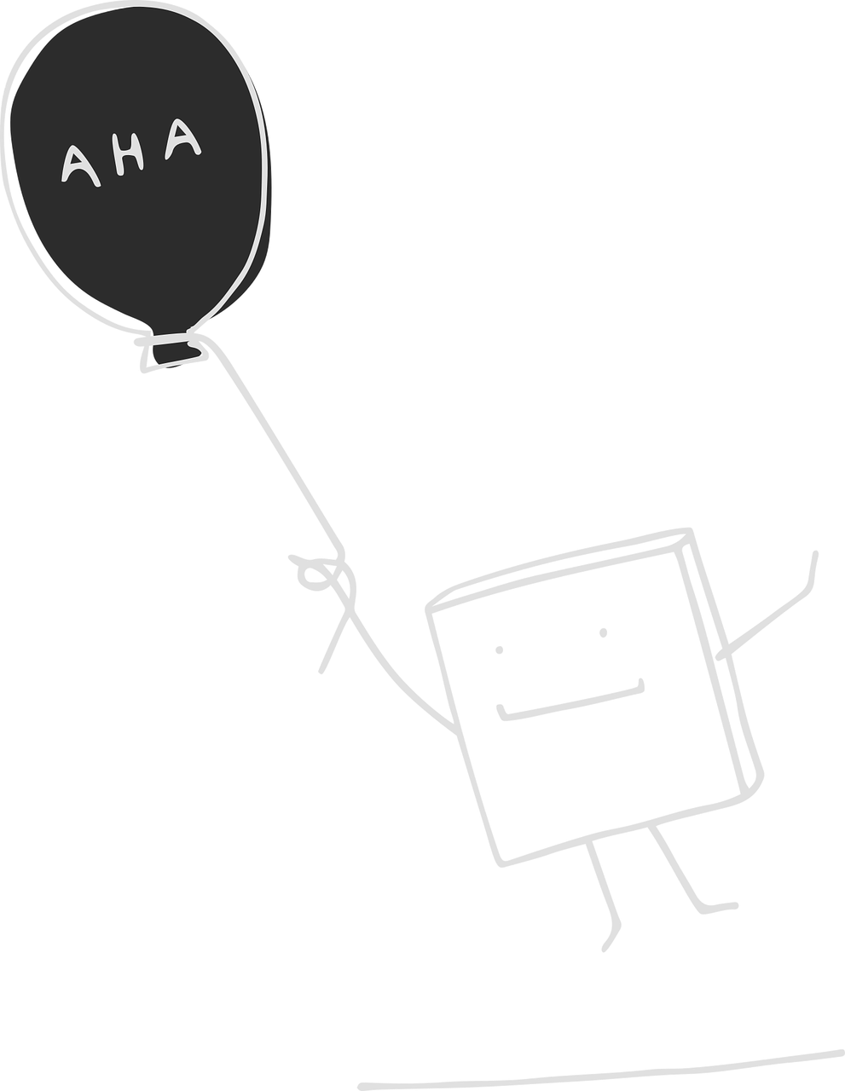
A-ha moment
“
Supporting DOAJ can be a complex decision making process in many institutions.
”
Illustration by Manfred Steger (CC 0)
Notes:
Illustration from Pixabay: https://pixabay.com/vectors/pixel-cells-balloon-flying-6230151/

Slide 25

Example slide

Slide 26



Text can go here
Where you can explain some key points

Slide 27









Shapes you can use

Slide 28












Shapes you can use

Slide 29












Shapes you can use

Slide 30


Shapes you can use

Slide 31











Shapes you can use

Slide 32







Shapes you can use

Slide 33
Example slides
(you can grab any of these as they are)

Slide 34
What is the Directory of Open Access Journals?

Slide 35
About DOAJ - Directory of Open Access Journals
1
A unique and extensive index of diverse peer-reviewed open access journals.
2
Mission to raise profile, visibility and impact of all quality OA journals, globally regardless of discipline, geography or language.

Slide 36
About DOAJ - Directory of Open Access Journals
3
Our criteria are a global gold standard for open access journal publishing, trusted across the scholarly community.
4
Our services and metadata are provided completely open to all.

Slide 37

DOAJ and the history of open access
2003
2014
2016
2020 onwards
Founded in 2003 during the “Innovation Years” of open access
Soon became the primary index for Open Access journals
Inclusion criteria are extended to ensure only trustworthy journals are indexed
Established our Ambassador programme to support and develop open access journals worldwide
Integrated into funder open access policies and workflows worldwide, for example Plan S Journal Checker Tool, the South African DHET list and the Indian Medical Journals list

Slide 38
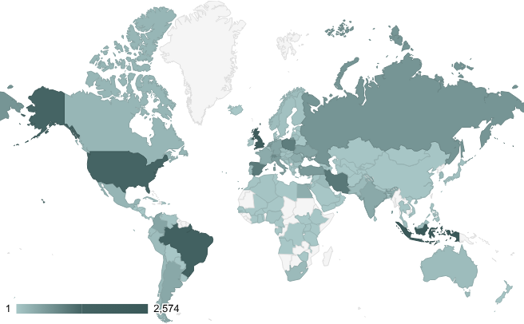
Overview of publisher countries indexed in DOAJ
Data collected 7th October 2025

Slide 39
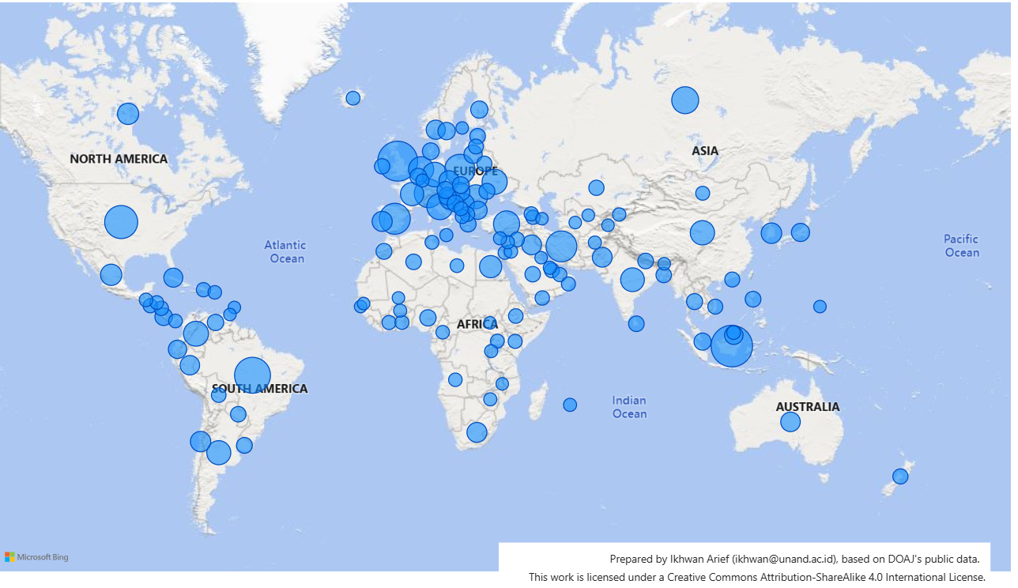
Geographic spread of journals in DOAJ
Notes:
The top 5 countries represented in the index are from Indonesia, UK, Brazil , US and Spain.
English is the dominant language represented in DOAJ, and to increase language diversity we have individual projects in the pipeline

Slide 40
89
140
22,000
More than
languages
countries
journals

Slide 41
Editorial statistics 2023
7,926 applications & 4,126 update requests from journals
24% of applications accepted for inclusion
Average review time under three months
20 core staff, >100 volunteer editors & 12 ambassadors

Slide 42
Editorial statistics 2024
Almost 8300 applications & nearly 4000 update requests from journals
23% of applications accepted for inclusion
13 editorial staff, plus over 100 volunteer editors

Slide 43
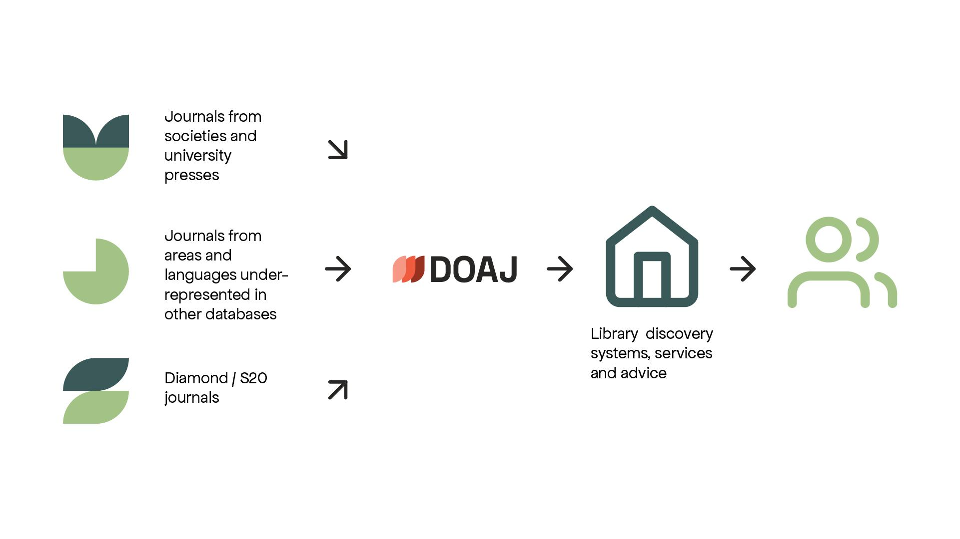

Slide 44
Who are the DOAJ team?

Slide 45
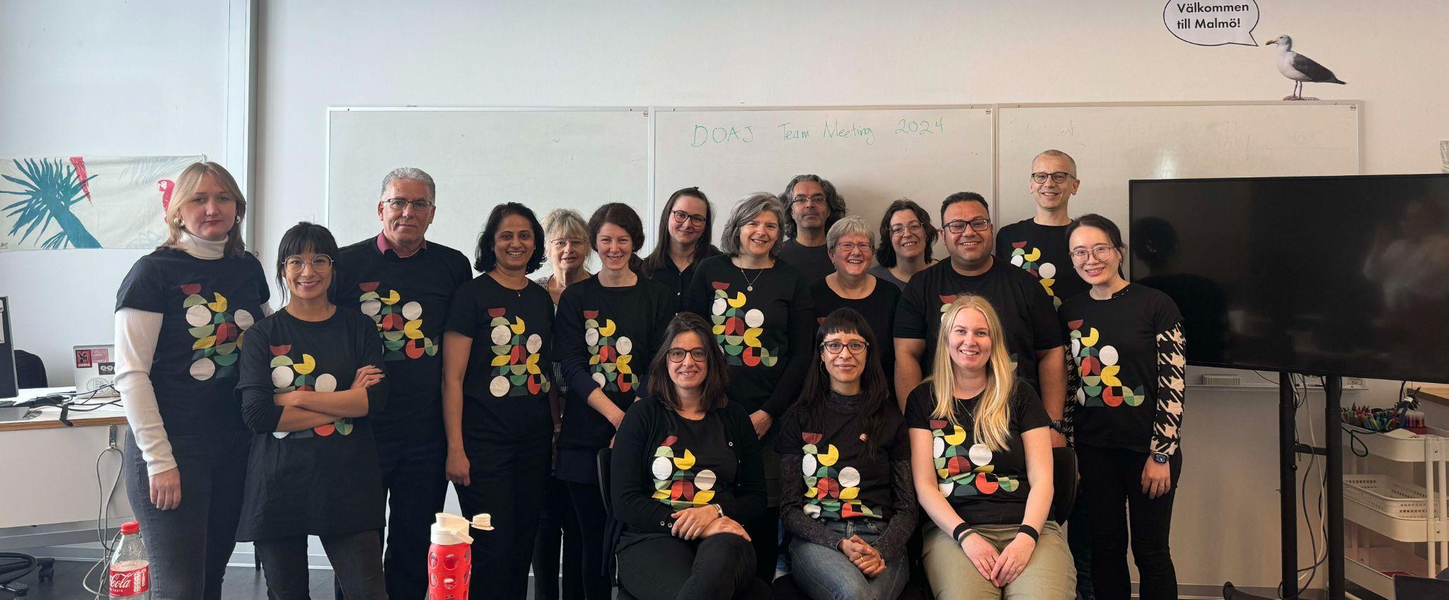
DOAJ team
Team photo taken during a team meeting in Malmö in April 2024

Slide 46
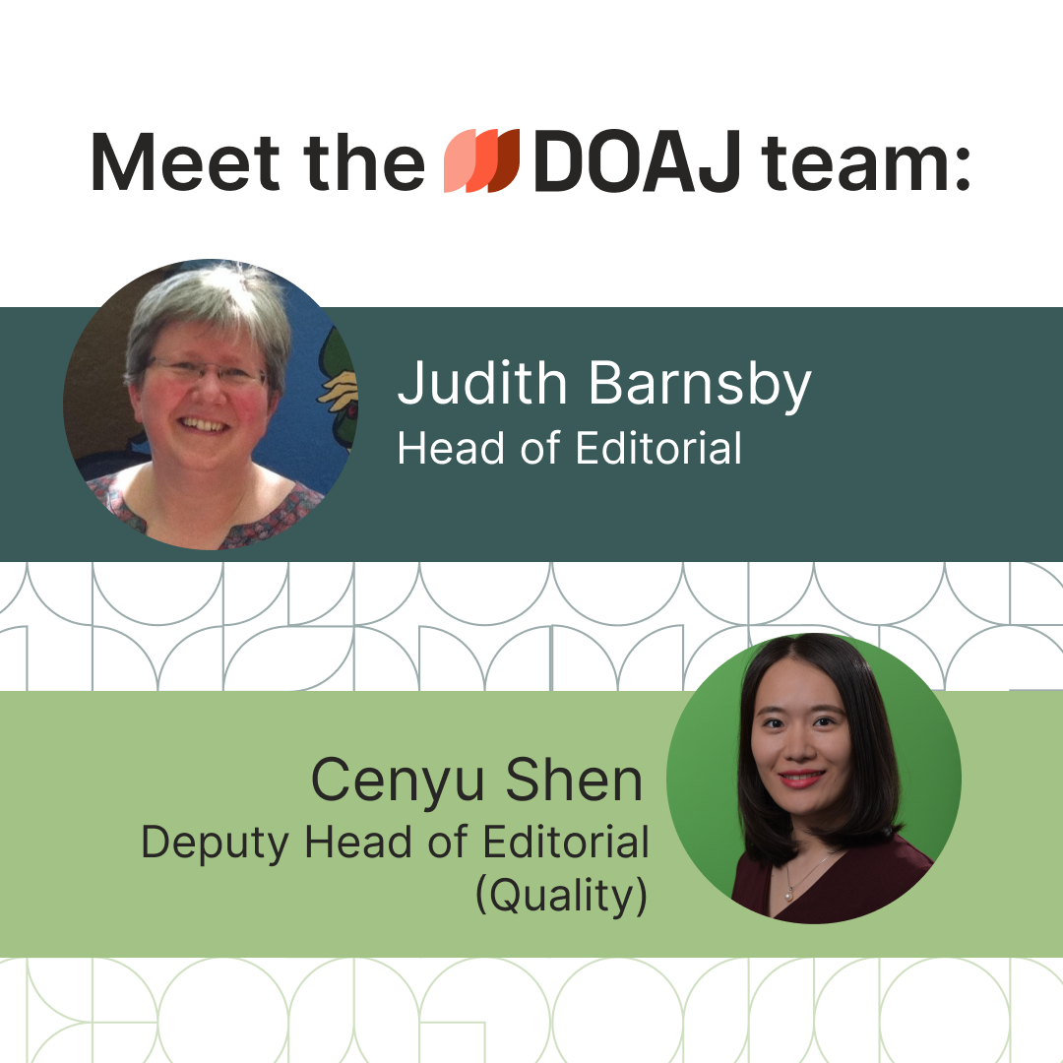
Get to know our team members through our “Meet the DOAJ team” blog post series
https://blog.doaj.org/2024/06/26/meet-the-doaj-team-head-of-editorial-and-deputy-head-of-editorial-quality/

Slide 47
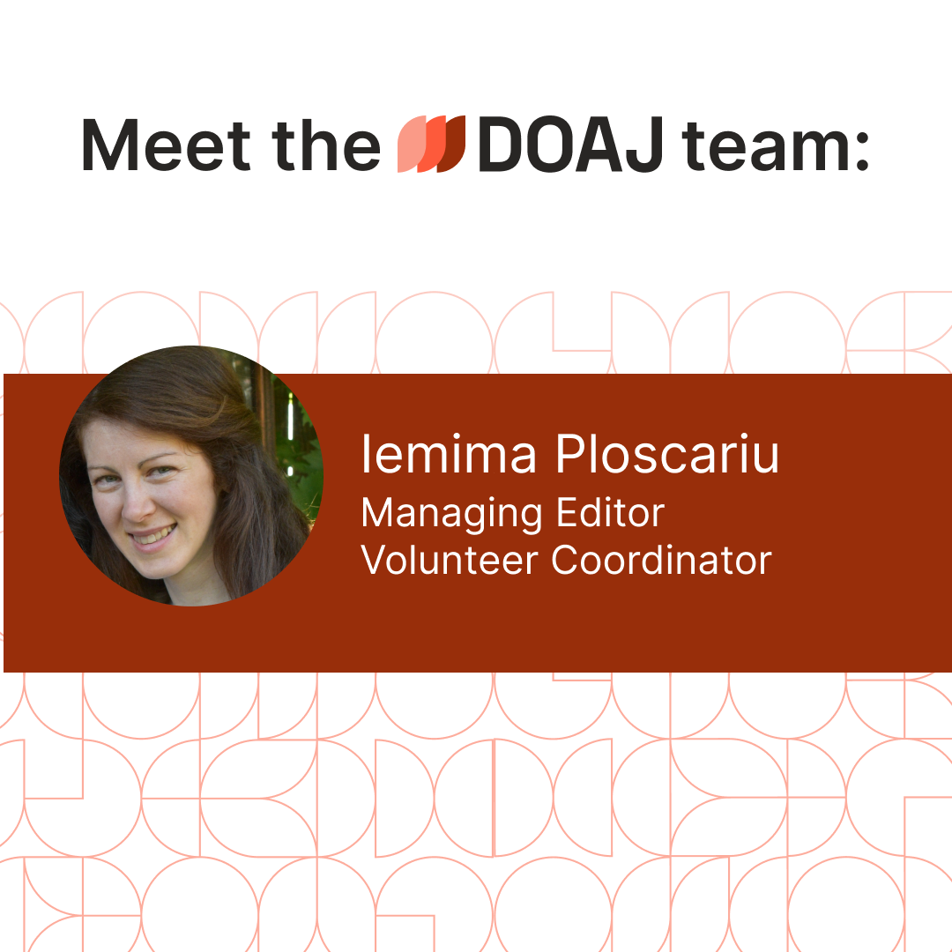
Get to know our team members through our “Meet the DOAJ team” blog post series
https://blog.doaj.org/2024/09/05/meet-the-doaj-team-managing-editor-and-volunteer-coordinator-iemima-ploscariu/

Slide 48
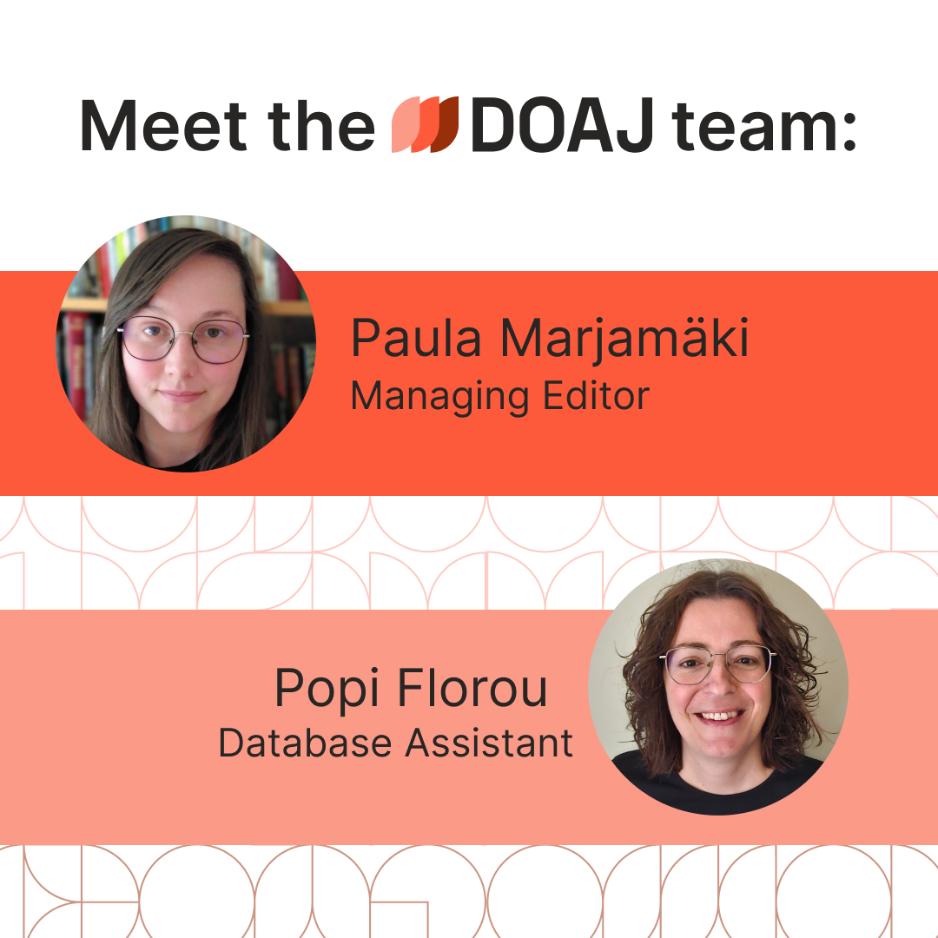
Get to know our team members through our “Meet the DOAJ team” blog post series
Not published yet - link to be added

Slide 49
DOAJ team and volunteers
21 core staff (12 FTE) of which 13 are Managing Editors
3 Senior Ambassadors and 14 Ambassadors covering 7 regions/countries
>100 volunteer Editors and Associate Editors

Slide 50
Why index journals in DOAJ?
Demonstrate your journal meets good publishing standards
Attract authors and readers from domestic and global networks
Inclusion of journals in all languages
Increase discoverability of your journal in search engines and indexing services
Enhance the reputation and societal impact of your journal (also in your country)
DOAJ-indexed journals are included in government lists (For example, DHET, South Africa)

Slide 51
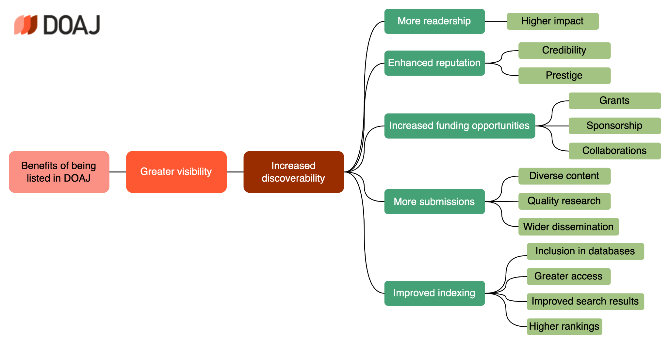

Slide 52
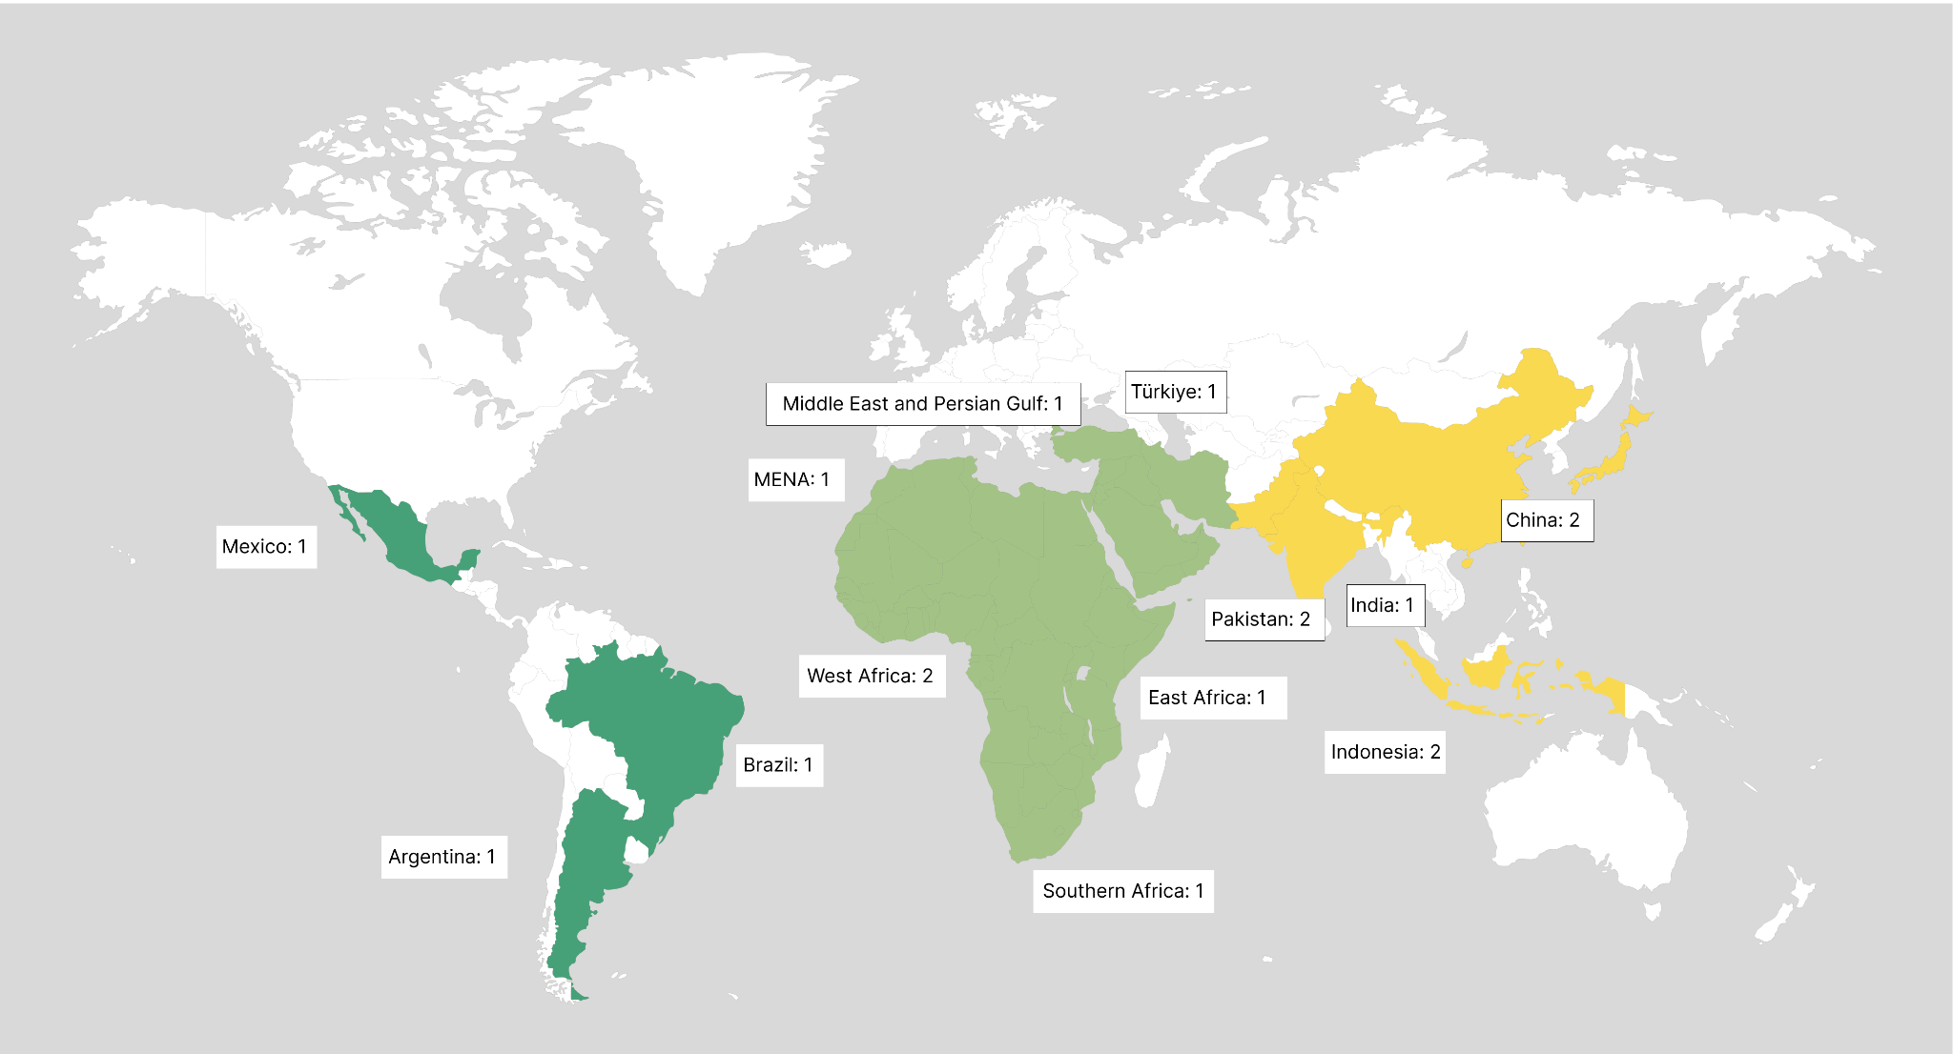
DOAJ Ambassadors 2025

Slide 53
In 2024, Ambassadors took part in 84 public engagements and events around the world

Slide 54



Community projects to support OA journals
Through a range of tools and practical resources, this international, cross-sector initiative aims to educate researchers, promote integrity, and build trust in credible research and publications.
JASPER is an initiative to preserve OA journals
The OA Journals Toolkit is an online resource that provides guidance for new and established OA journals

Slide 55
DOAJ as an open scholarly infrastructure…
1
cannot be bought or sold.
2
is committed to openness, diversity and accountability.
3
has adopted the Principles of Open Scholarly Infrastructure in 2022.
4
collaborates with other open infrastructures to drive change towards an open and transparent culture.
Notes:
Collaborates: eg author of Principles of Transparency and Best Practice in Schol. Publishing and founding organisation of Think.Check.Submit

Slide 56

DOAJ and the community
Founders of
Endorsed by

Slide 57



DOAJ and the community
Partners of

Slide 58

https://www.oajournals-toolkit.org/
Self-guided online resource
Launched in 2023 by OASPA and DOAJ
Content created by a diverse Editorial Board of experts in the field
Editorial Board responsible for keeping the content up to date
Available in English, French, Arabic, Spanish and Portuguese

Slide 59
Breaks down essential information for OA journals
Getting started
How to set up an OA journal
Running a journal
Editorial considerations of journal management
Indexing
How to build and maintain your journal’s profile
Staffing
How to build roles and responsibilities
Policies
How to develop policies and guidelines for your authors
Infrastructure
Find out more about establishing and running an online journal

Slide 60
“
It's a fantastic resource, if it didn't exist you'd have to invent it. Whenever I'm providing any advice for staff and students on our journals, I check the guide, inevitably it already has everything we need. We knew we wanted to benchmark our titles against the excellent standards held by OASPA and DOAJ. The toolkit provides an easy way for us to provide guidance to everyone involved in our journal projects.
”
UK Scholarly Communications Librarian on the OA Journals Toolkit

Slide 61
JASPER aims to close the gap in preservation coverage among open access journals.
To be eligible for JASPER a journal must
Be indexed in DOAJ, including articles
Not charge any fees or be subsidised in any way
Operate with a CC BY license, where keeps copyright
Not already have a commercial contract with an archiving solution
The JASPER service is free of charge.
Service partners:
CLOCKSS
DOAJ
Internet Archive
Keepers Registry
PKP

Slide 62
Editorial process

Slide 63
To be indexed, journals must apply …
The journal must…
Meet DOAJ basic criteria
Be fully open access
Be actively publishing peer-reviewed research

Slide 64
Initial checks are made by the Triage team
These checks include…
ISSN(s) are fully registered at issn.org
Journal website is available
Full text articles are available without delay or registration
Copyright and licensing information is given

Slide 65
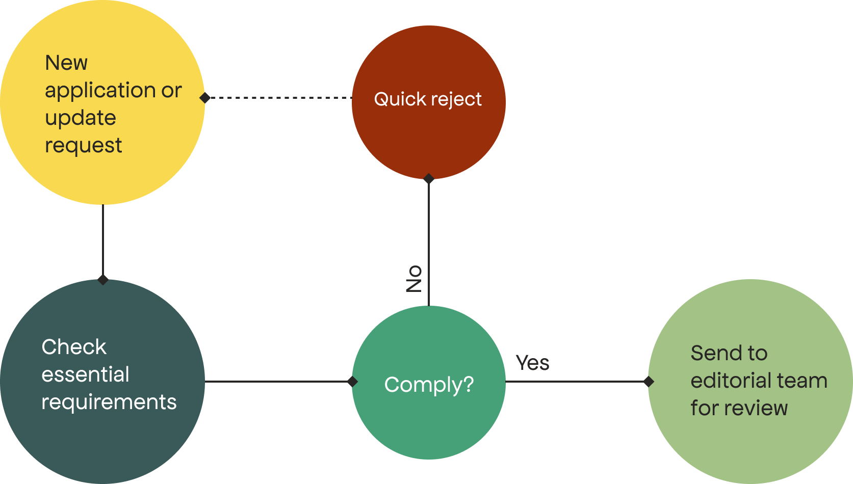
DOAJ Triage

Slide 66

All applications passing triage undergo review
DOAJ volunteers or staff…
Check application against journal website
Contact publisher/editor with queries
May identify areas of concern
Recommend to accept or reject
Illustration by Clker-Free-Vector-Images (CC 0)
Notes:
Illustration from pixabay: https://pixabay.com/vectors/loupe-lens-zoom-magnifier-310395/

Slide 67
Final decision by DOAJ staff
DOAJ Managing Editor…
Reviews application and recommendation
May undertake further review or return with queries
Makes final decision to accept or reject

Slide 68

Feedback to publisher
After final decision…
Automated email sent to journals accepted for inclusion
Journals appear in DOAJ immediately
Automated or manual email sent to rejected journals
Publisher/editor must usually wait for 6 months before reapplying
Illustration by Satheesh Sankaran (CC 0)
Notes:
Illustration from pixabay: https://pixabay.com/vectors/chat-communication-icon-talk-6183068/

Slide 69
Current application processing time:
3 months

Slide 70
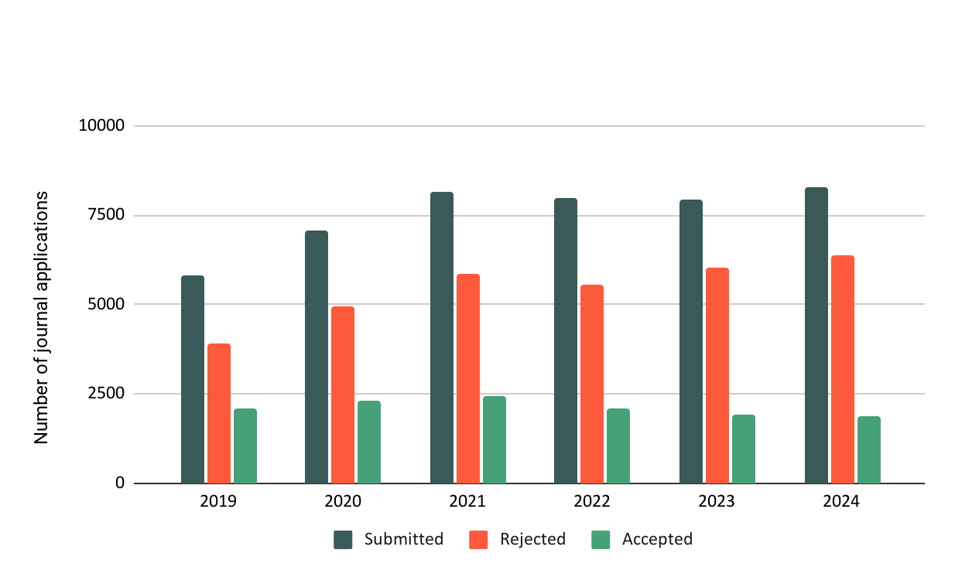

Slide 71
DOAJ criteria, application process, and (sometimes) rejection help journals increase their own standards.

Slide 72
“
DOAJ indexing was a difficult but doable process. We enjoyed working with the DOAJ team as support in the work process.
”

Slide 73
“
Firstly, our application was rejected, as we did not have proper copyright arrangements. After that, we consulted with some experts and lawyers, adopted the CC copyright model, and arranged everything else in order to really become an open access journal.
”
Feedback collected between 31st Jan - 14th Feb 2023, from survey on journals indexed in DOAJ 1st Jan to 30th June 2021.

Slide 74
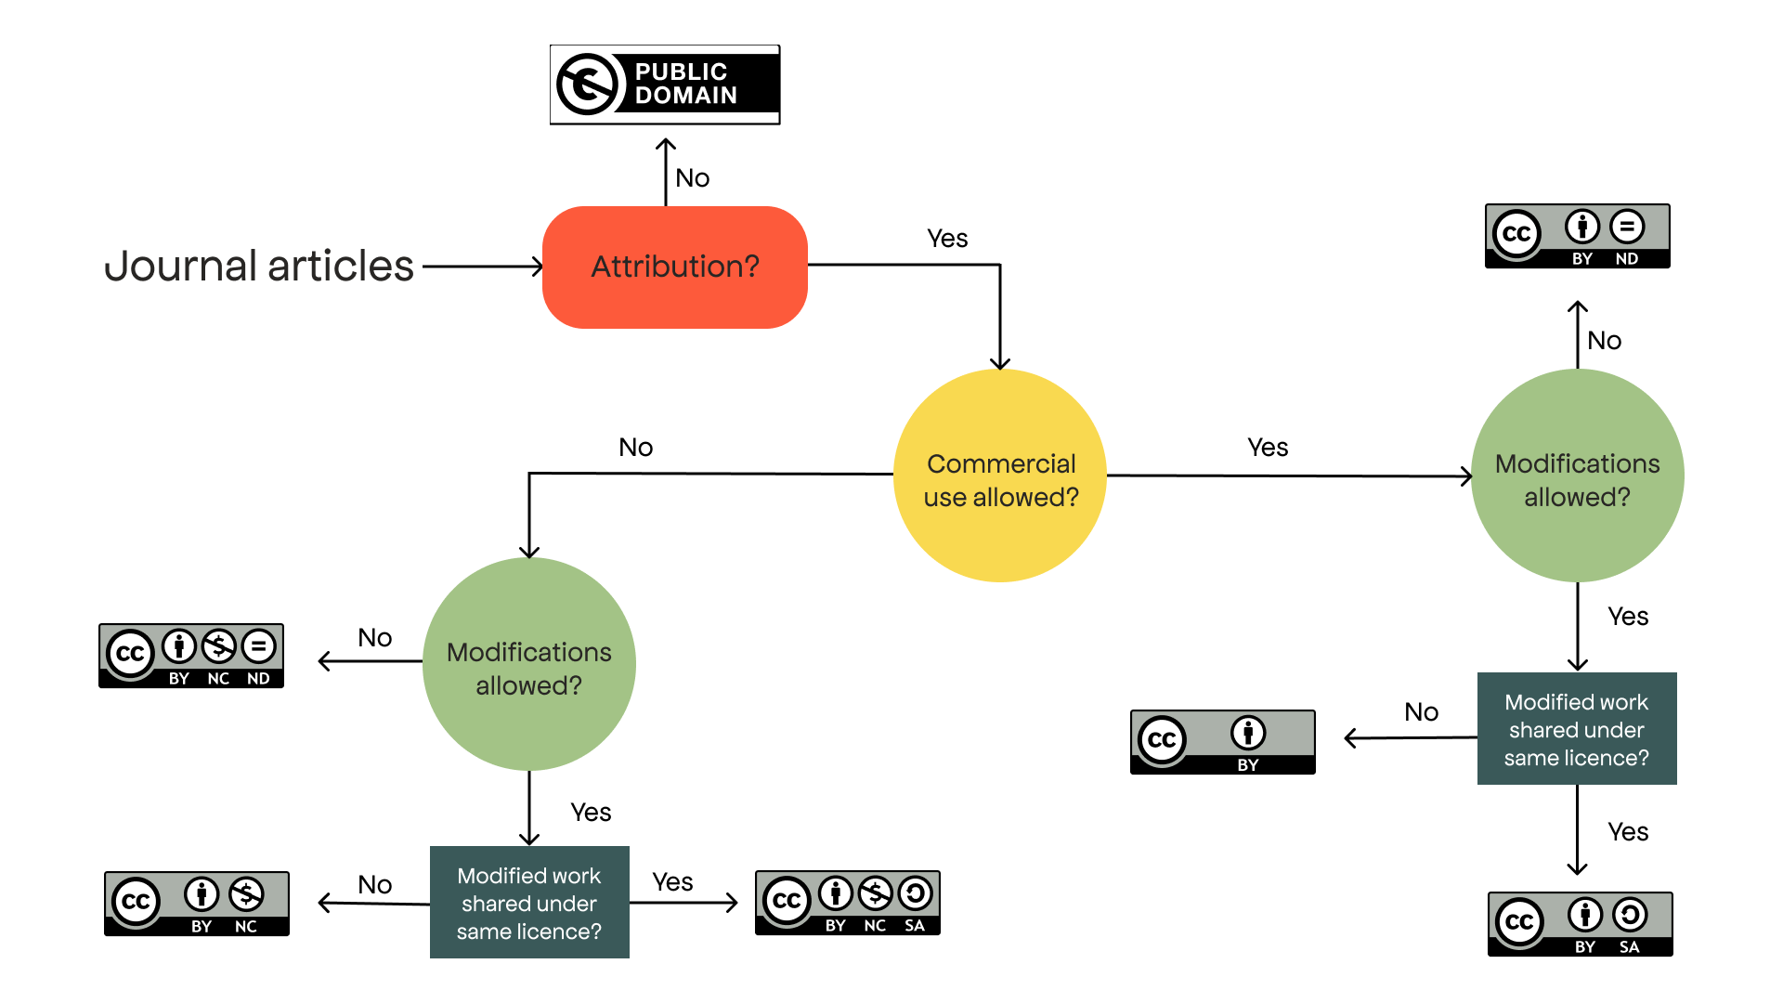
Licensing

Slide 75
Copyright best practice
Authors retain copyright of their work
Publisher has the right of first publication
Recommended but not required for inclusion in DOAJ
Authors also retain full publishing rights
Publisher is granted non-exclusive rights to publish and distribute
Publishers cannot license rights to third parties
Authors can reuse their work without restriction
Recommended but not required for inclusion in DOAJ

Slide 76











Terms
Creative commons licenses
Attribution
CC BY
Others can copy, distribute, display, perform and remix your work if they credit you as the creator.
CC by SA
Share Alike
Others can distribute your work only under a license identical to the one you have chosen for your work.
CC by NC
CC by ND
No Commercialisation
Others can copy, distribute, display, perform or remix your work but for non-commercial purposes only.
CC by NC SA
No Derivatives
Others can only copy, distribute, display or perform verbatim copies of your work.
CC by ND NC
Information from https://creativecommons.org/share-your-work/cclicenses/

Slide 77
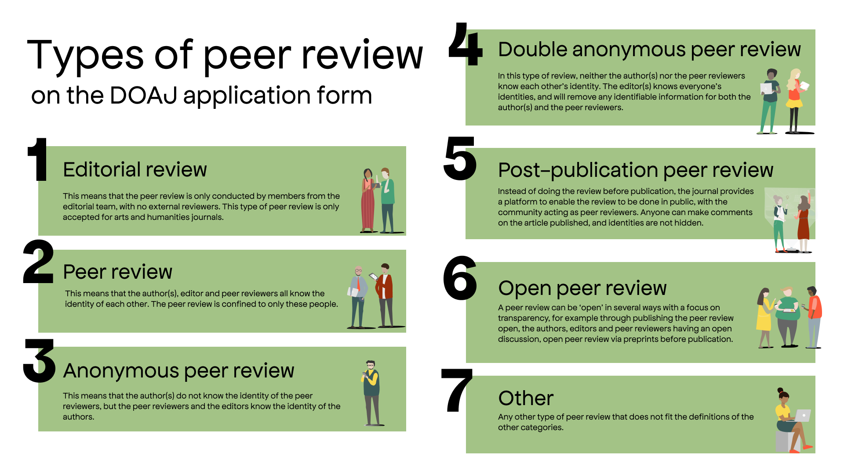
Notes:
Policy decided by editor and editorial board

Slide 78
Supporting DOAJ

Slide 79
How DOAJ is funded
600+ University libraries from 36 countries
17 Library Consortia from 13 countries
10 Research Funders/Academies of Science
30+ smaller publishers
25+ larger publishers and aggregators
80% of income from the community
20% of income from publishers

Slide 80
How DOAJ is funded
DOAJ was founded by a librarian (Lars Bjørnshauge) after a suggestion from the audience at the Nordic Conference on Scholarly Communication in 2003. Bo-Christer Björk compiled the first list of 300 journals.
80% of income from the community
20% of income from publishers
Notes:
Just want to stop and point out why the income to DOAJ comes mainly from the community - because DOAJ truly is a community-led organisation that has grown organically from librarians willingness to work together to create a better scholarly comms landscape.

Slide 81
How librarians and research support staff use DOAJ
Our metadata is integrated with library discovery systems & gives users access to a more diverse range of content
Our metadata is used in other systems used by libraries and enabling a transition to OA, eg. Unsub, Plan S Journal Checker Tool, Sherpa Romeo

Slide 82
How librarians and research support staff use DOAJ
Source of trusted quality journals when advising researchers where to publish
Checking for inclusion in DOAJ is embedded in Open Access workflows, i.e. allocating funding for APCs

Slide 83
Why support DOAJ?
1
Funding from libraries enables our commitment to being 100% independent.
2
Data and services can be open to everyone.
2
DOAJ has been created and is developed by the community, for the community.

Slide 84
Why support DOAJ?
4
Supporting open infrastructure is a strategic choice for libraries, and demonstrates a commitment to open research and a sustainable future for open infrastructure.
5
Demand for (and pressure on) our services is increasing in line with the growth of Open Access.

Slide 85

Funding to maintain open infrastructures is often not prioritised
Invisible yet essential services often go unnoticed
Grants and investments are directed at innovative projects or new platforms

Slide 86
DOAJ’s priority is to support the needs of our community
New projects
Maintaining DOAJ’s growing demand

Slide 87
From 2024 we have introduced a new supporter model

Slide 88
The demand for our service is growing

Slide 90
Our specially trained quality team investigates 400 cases of suspected questionable practices each year

Slide 91
Our metadata

Slide 92
Our metadata is widely used
Discovery services and aggregators
OpenAlex, Web of Science, Scopus, Proquest products, EBSCO products, Google Scholar, OCLC, WorldCat, Dimensions, CORE, ROAR, Research4Life portals, OpenAIRE and many more
Search engines
Google, Bing, Yahoo, DuckDuckGo
Notes:
Referral rate to DOAJ is extremely high: 75%! People trust DOAJ and trust that the content and journals that they find there

Slide 93
Our metadata is widely used
AI solutions such as ChatGPT
University discovery systems and library portals
The metadata is open to use, re-use and distribute
There are five different formats: CSV file, full data dump, OAI-PMH, Atom feed and our API
Notes:
Referral rate to DOAJ is extremely high: 75%! People trust DOAJ and trust that the content and journals that they find there

Slide 94
Metadata integrations
Our metadata is also integrated into many tools, such as:
Plan S’ Journal Checker Tool (JCT)
B!SON OA Journal Recommender
Open Access Journal Finder, from Enago
SciFree’s Journal Search Tool
BASE (Bielefeld Academic Search Engine)
JURN
ChronosHub’s journal finder
Notes:
Plan S’ Journal Checker Tool (JCT)
B!SON OA Journal Recommender
Open Access Journal Finder, from Enago
SciFree’s Journal Search Tool
BASE (Bielefeld Academic Search Engine)
JURN
ChronosHub’s journal finder

Slide 95
Our role has evolved

Slide 96
We require funding to invest in our strategic goals
Advocate for equity and diversity in open access journal publishing
Use our trusted position to raise the profile of high-quality open access journals
Increase the sustainability and resilience of our service to enable it to adapt to the needs of the community

Slide 97
Questions?
Katrine Sundsbø
Community Manager
katrine@doaj.org
@katrinesundsbo

Slide 98
Some other presentations you might find useful
IFLA 2023 Moving the needle
The business model of open access. Who pays?
2022 update on projects, partnerships and collaborations
TEMPLATE DOAJ slides theme
OPEN - intro & wrap up
Canadian Association of Learned Journals June 2023
Separating the wheat from the chaff: How to identify quality open access journals?
Troubleshooting API and XML queries
More guidance on layout, colours, design: https://doaj-kit.netlify.app/

